Slide 1

Computer Vision

Slide 2
Introduction to Image processing
1
With openCV

Slide 3
Introduction to Artificial Neural Networks
2
With numpy, keras

Slide 4
Introduction to Convolutional Neural Networks
3
Giving computers the power to see...almost

Slide 5
Face Recognition
4

Slide 6
Object Detection and Localization
5

Slide 7
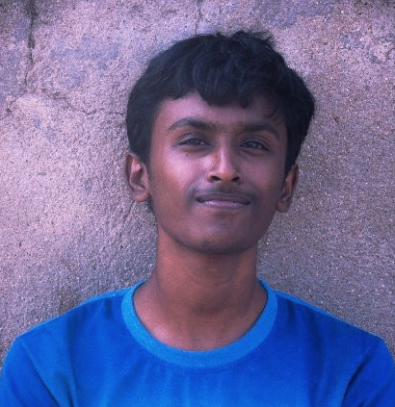
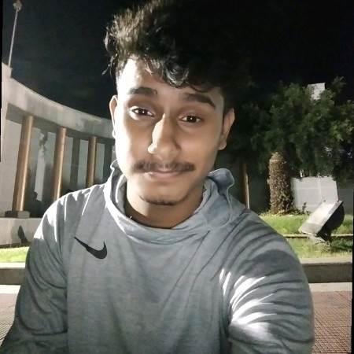
Connect with us
Surya K
https://www.linkedin.com/in/surya-krishnamurthy
https://github.com/SuryaThiru
Apurva Nitanjay
https://www.linkedin.com/in/apurva-nitanjay-9825801/
https://github.com/apuayush

